Slide 1
A Closer Look at Methods and Classes
MODULE 2
Chapter1

Slide 2
Closer look at methods
Controlling access to class members
Pass objects to methods
How arguments are passed?
Returning objects
Method overloading
Overloading constructors
Recursion
Understanding static
Introducing nested and inner class
Var args: Variable-length arguments

Slide 3
Java’s Access Modifiers
Java’s access modifiers
public : accessible everywhere
private : accessible within class only
protected : accessible within package and outside the package but through inheritance only
default : accessible available to the package only

Slide 4
Pass Objects to Method
We can pass an objects to a method
class Sample{
int data;
Sample(int d){
data=d;
}
void show( ){
System.out.println(“Data= “+data);
}
}
class MyProgram{
static void increase(Sample p){
p.data =p.data +1;
}
public static void main(String args[]){
Test t = new Test(5);
increase(t);
t.show( );
}
}

Slide 5
Call- By- Value
class Program{
static void increase(int p)
{
p =p+1;
}
public static void main(String[ ] args){
int a=5;
increase(5);
System.out.println(“A = ”+a)
}
}

Slide 6
2. Passing objects to methods
At an airport, a traveler is allowed entry into the flight only if he clears
Baggage check
Class diagram
Call-by-reference
Passenger
Checks
bagWeight : int
+ checkBaggage(Passenger) : boolean
+ getBagWeight( ) : int
+ setBagWeight ( int ) : void
Demo
+ main(String) : void
Call-by-Value

Slide 7
3. How arguments are passed?
Demonstrate: call-by-value Vs. call-by-reference
setBagWeight( 35 ) ; // passing constant
checkBaggage(Passenger object) ; // where Passenger is a object
Call-by-value
Call-by-reference

Slide 8
4. Returning objects
Class Name: Demo
count : is a instance variable of type int
Constructor(int):
intialize count int user value.
incrementBy(int) : Demo
creates temp object setting count incremented by user specified value.
must return the temp object
Main(): method to implement above structure.
Main has 2 objects ob1 and ob2.
Ob1 sets count to 2
Ob2 gets incremented value of ob1
Demo
count : int
+ Demo ( int )
+ incrementBy ( int ) : Demo
+ main(String) : void

Slide 9
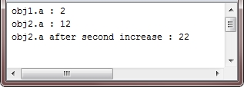
class Test {
int a;
Test(int i) {
a = i; }
Test incrByTen( ) {
Test temp = new Test(a+10);
return temp;
}
}
public class JavaProgram {
public static void main(String args[]) {
Test obj1 = new Test(2);
Test obj2;
obj2 = obj1.incrByTen();
System.out.println("obj1.a : " + obj1.a);
System.out.println("obj2.a : " + obj2.a);
obj2 = obj2.incrByTen();
System.out.println("obj2.a after second increase : " + obj2.a);
}
}

Slide 10
6. Overloading Constructor
Controlling access to class members
Pass objects to methods
How arguments are passed?
Returning objects
Method overloading
Overloading constructors
Recursion
Understanding static
Introducing nested and inner class
Var args: Variable-length arguments

Slide 11
5. Method overloading
Syntax:
class className {
- - -
returnType methodName( arguments-1 ) {
- - -
}
returnType methodName( arguments-2 ) {
- - -
}
}

Slide 12
5. Constructor Overloading
Syntax:
class className {
- - -
className( arguments-1 ) {
- - -
}
className( arguments-2 )
-----}
}

Slide 13
5. Method overloading 6. Constructor overloading
Example..

Slide 14
7. Recursion
What is Recursion ?
“Process of calling a method by itself”

Slide 15
7. Recursion
Mathematical definition
factorial (n) = 1 if n = 0
n . factorial(n-1) if n > 1
Factorial
Demo
+ getFactorial( int ) : int
+ main(String) : void

Slide 16
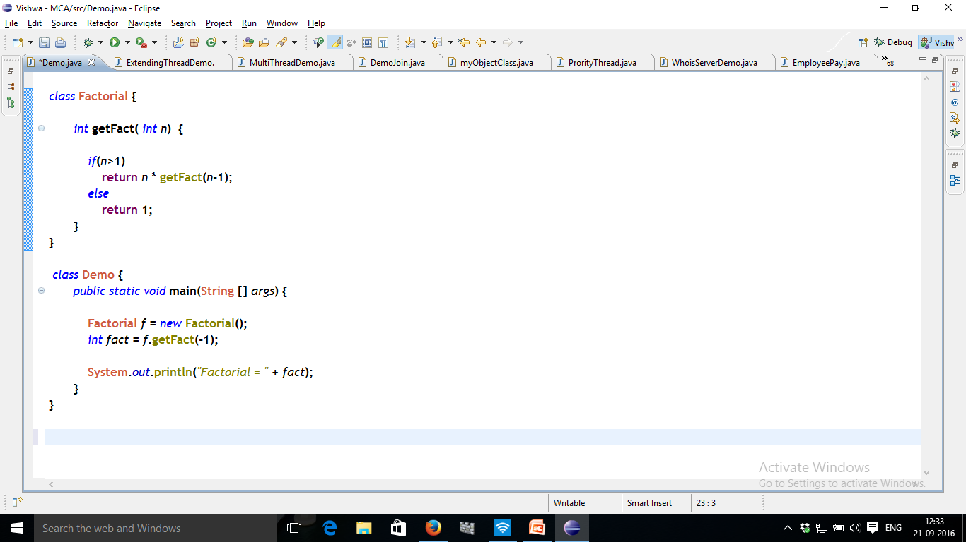
7. Recursion
5

Slide 17
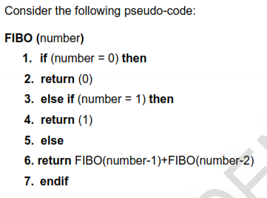
7. Recursion
recursion to find Fibonacci numbers

Slide 18
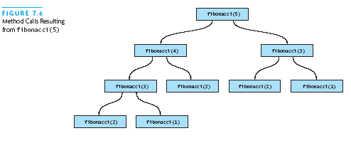

Slide 19
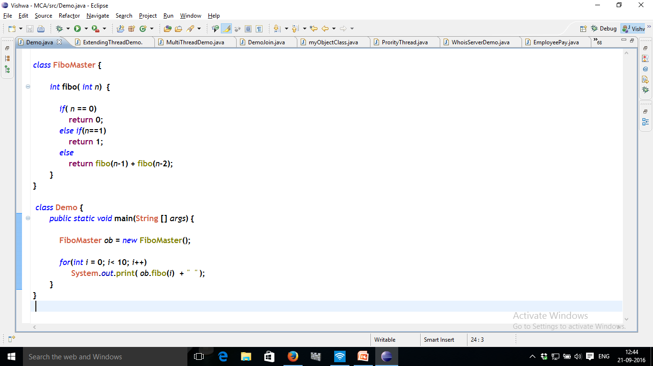
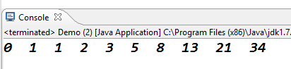

Slide 20
8. Understanding static
Different uses of static are..
Static variable
Static method
Static block

Slide 21
8.1. Static Variable/ static method
Static variable/method:
Declared with static keyword.
Accessing static member
No object needed to access static members
class A {
static int a; // static variable
- - -
}
className.variable;
className.method();

Slide 22
8.1. Static Variable/ static method
Example:
class staticMaster {
static int a; // static variable
static void show() { // static method
System.out.println(a);
}
}
class Demo {
public static void main(String [] args) {
staticMaster.a = 10;
staticMaster.show();
}
}

Slide 23
8.2. Static method
Restrictions on static method
They can only call other static methods.
They must only access static data.
They can not refer to 'this' or 'super' in any way.
They can not refer instance variables.

Slide 24
8.3. Static block
Gets executed exactly once, when the class is first loaded.
Used to initialize static variables.
Why need static block
If you need to do computation in order to initialize your static variables,
Demonstrate example
Define class StaticDemo with member shown in class diagram
Set basic to 5000 with declaration itself
Set DA to 10% of basic in static block
Calculate salary in staticShowSalary() method and display it
Call staticShowSalary() from main() method.
StaticDemo
- BASIC = 500 : static float
- DA : static float
+ static { }
+ staticShowSalary() : void
+ main(String) : void

Slide 25
8.3. Static block
class StaticDemo {
static float basic = 5000;
static float DA ;
static {
System.out.println(“..Static block ..”);
DA = basic * 0.10;
}
static void showSalary() {
System.out.println(“..Static Method ..”);
float salary = basic + DA ;
System.out.println(“Net salary = ” + salary);
}
public static void main(String[] args) {
StaticDemo.showSalary(); // No object needed
}
}
Execution steps:
StaticDemo class is loaded
which Run all static statements
basic is set to 5000,
static block executes and DA is set,
main( ) is called,
calls showSalary( )

Slide 26
9. Nested and inner class
Nested class
Is a class defined within another class;
Example:
Thus, if class B is defined within class A,
then B does not exist independently of A.
class A {
- - - -
class B { //Nested class
- - - -
}
}

Slide 27
Types of nested class
Nested class
Non-static class.
inner class
Static Nested class
class OuterClass
{
...
static class StaticNested
{ ... }
}
class OuterClass
{
...
class InnerClass
{ ... }
}

Slide 28
Creating instances
class Outer
{
...
class Inner
{ ... }
}
Creating instance of Inner Class
class Demo {
public static void main(String [] args) {
Outer outOb = new Outer();
Outer.Inner inOb = outOb.new Inner();
- - -
}
}

Slide 29
9. Nested and inner class
Example..
Lab program

Slide 30
10. Variable length arguments
Varargs – stands for variable-length argument
A method that takes a variable number of arguments.
called a variable-arity method, or simply a varargs method.
Different ways to handle variable-length argument
if the number of arguments was small and known, then use method overloading, one for each.
if the number of arguments was larger, or unknowable, then use Array. Add arguments into an array.
Specify variable-length argument by three periods (...)

Slide 31
Method-1
overloaded the methods ..
public …..main(…..) {
getSum(10, 20);
getSum( 5, 6, 4 );
getSum(10, 20, 30, 40);
getSum(10, 20, 30, 40, 50, 60);
getSum(4, 2, 6, 8, 3, 9, 22, 34, 11, 4, 6, 7);
so on..
How many overloaded the methods needed to achieve this..

Slide 32
10. Variable length arguments
Method2.. Implement program using array concept
int [3][]arr;
arr[0] = {5, 6, 4 };
arr[1] = {10, 20, 30, 40 };
arr[2] = {10, 20, 30, 40, 50, 60 };
doSum(arr[0]);
doSum(arr[1]);
doSum(arr[2]);

Slide 33
10. Variable length arguments
Syntax: | <returnType> MethodName(int ... arrayName) { -- }
Example: | static void vaTest(int ... v) { ------------------ }
This syntax tells the compiler that vaTest( ) can be called with zero or more arguments.
As a result, v is implicitly declared as an array of type int[ ].
Thus, inside vaTest( ), v is accessed using the normal array syntax.

Slide 34
10. Variable length arguments
Demonstrate program to find sum
Class: VarArgsDemo
doSum() method
Use foreach to find sum. Diplay the sum.
Main()
Call the method as shown below
VarArgsDemo
doSum (2, 5, 1, 8, 2);
doSum (10, 20, 30);
doSum (5, 2, 3, 5, 5, 2, 3);
sum : int
+ void doSum(int…v ) : int
+ main(String) : void

Slide 35
End..

